Slide 1

Computer Engineering Department
A.P. Shah Institute of Technology
G.B.Road, Kasarvadavli, Thane(W), Mumbai-400615 UNIVERSITY OF MUMBAI Academic Year 2020-2021

Slide 2
Online-Platform for Communication Between Students on Research and Innovation Issues.
A Project Report on
Submitted in partial fulfillment of the requirements in Department of Computer Engineering by Mansi Devrukhkar (17102057) Shreya Choudhary (17102018) Prathamesh Pitale (17102066) Chinmay Sawant (17102006) Under the Guidance of Prof. Merlin Priya Jacob

Slide 3
1.Project Conception and Initiation

Slide 4
1.1 Abstract
Our project highlights the need for development of an online platform targeted to solve communication issues of students in research and innovation. In the field of innovations, there is limited or no bank of useful links and materials for analysis of students and the information related to their research on innovative subjects are organized and can seek help from others via chat. Students can share their opinion on a subject. They will get to know about the upcoming technical events related to research and innovation. They can post blogs related to same that allow to form a general understanding of innovative activities for the students.

Slide 5
1.2 Objectives
To provide platform for communication for master's degree students, realizing the Internet socialization potential in the educational process, which can be used in open education technologies.
To deliver a functional website which is targeted towards master's degree students which will enable them to communicate, collaborate and discuss their research and analysis results with like-minded individuals which are working on a related domain/topic as they are.
Understand latest web technologies (HTML, CSS, PHP, JavaScript, SQL).

Slide 6
1.3 Literature Review
1.3.1 Development of Web-environment for Communication Between Master's Degree Students on Research and Innovation Issues . This paper states the need for an internet environment for communication between Master’s Degree students on research and innovation issues. They found out that there were many sites especially for master’s degree students but they did not include any forms of communication, they were just for educational purpose or bulletin boards. All websites have their own specialty but there is a need to integrate all this to form a single website for master’s degree student. They developed a website for master’s degree students where they can communicate with each other on the topic of implementing innovative and research projects. There was an “Events” page where latest information of events in field of research and innovation were mentioned. In schedule activity students could create an activity chart for specified period. In this way, they created a website for communication between Master’s degree students.

Slide 7
1.3.2 Review on “Really Simple Syndication (RSS) Technology Tools” [4] In this paper, the author tries to explain the RSS and the different Tools where these are used. According to him, a user is always in search of up-to- date information. The author says It is a tedious task for a common user to get the desired information from the vast Internet. To overcome this type of problem, the user needed RSS technology for ease of access. Also, RSS technology always helps to attract more users. It is also used in the education field to enhance research methods for students. Students can use this tool to gather existing information from online journals, weblogs, publications, and other sources. RSS and web files together connect students and avail them to share researches over the Internet. RSS means Really Simple Syndication, Rich Site Summary, and RDF (Resource Description Framework) Site Summary. RSS uses XML code that detect new information and update itself by feeding the information to the subscribers. The author also summarizes the tools which are used for RSS feeds.

Slide 8
1.3.3 The Design and Implementation of Responsive Web Page Based on HTML5 and CSS3 [5] This paper states that the problems of web pages being displayed at different platforms in different resolutions and in different screen sizes can be solved using responsive web design. Also, web responsive pages bring high-quality experience to users. This paper states that responsive web design on HTML5 and CSS3 proves to be more feasible and effective. The paper focuses on design ideas and key technologies of risk of responsive web design with responsive enterprise website with the help of related technologies of HTML5 and CSS3.The responsive web page will automatically detect the screen size of the device and adjust the page layout accordingly thus ensuring that the content on the page is displayed normally on desktop, pads, mobile phones and other devices.

Slide 9
1.3.4 Analysis of web content delivery effectiveness and efficiency in responsive web design using material design guidelines and user centered design [6] The author sites the rise of mobile technology in recent times stating that with rise in the number of internet users business are keen to tap is phenomenon to increase the number of customers. To do this, businesses are hiring a lot of developers to create and deploy websites and primarily to target the mobile users. In order to develop a website that is consistent across all devices developers are resorting to using a framework that is responsive and adapts itself to the device. This is where his research comes in where is analyses the effectiveness of various designs. He states the need to have a design that is simple, intuitive and user friendly but at the same time easy to develop and modify. The author emphasizes the need to develop a user-centered design which puts the focus on the user which means that before even starting to code one needs to analyses the target audience. He then goes on to explain the recent phenomenon of Material design in which he combines with the concept of user-centered design and how combining both of these modern approaches is improves the effectiveness and efficiency of information delivery of a web page.

Slide 10
1.3.5 Component-based Engineering of Web User Interface Designs [7] The Author emphasizes the need for component-based approach for modern web engineering purposes because according to him this method of designing websites and applications reduces bloat ware, saves time, increases code reusability and in all makes it much easier to maintain and upgrade the application to deal with changing user requirements. In this paper the author has specified a certain method to design web user interface designs from configurable components. The author uses an evolutionary algorithm for continuous and rapid development of web use interface design. In this paper the author has strongly championed the use of DRUPAL as the organization framework. DRUPAL is a free and open- source web-content management framework written and distributed in PHP under the GNU General Public License. The author has described two tools first one is a web intelligence miner and second one is a web UI screenshot analyzer. Web Intelligence miner is a tool which performs the process of gather data related to websites this data can be domain name, tasks, user demographics and health of the website. The second tool Screenshot analyzer has the job of taking a screenshot of the UI of the website so that it can be cross-checked with the previous version.

Slide 11
1.4 Problem Definition
It has been found that [1], there are variety of websites and web-based applications for students of technical background, a significant part contains only educational programs and bulletin board. As a result, there is no platform for students of innovation to socialize. Many platforms contain few key components, but there is a lack of integral framework of all components in the field of innovation, there is no given opportunity of team work on projects. Considering social networks for students do not provide an opportunity to get acquainted with innovative activities in the field. This analysis further led for the need of development of internet environment for students to communicate for research-based activities.

Slide 12
1.5 Scope
We are building a web-based platform which will provide all the necessary information in order to form a general understanding of innovative projects, competitions events for students. Students are given the opportunity to find like-minded people for team research activities, as well as keep records of results of project activities using his/her personal account. The Internet environment being developed by us for training students is based on an innovative approach and gives an opportunity for students to communicate on the topic of implementing innovative research projects.

Slide 13
1.6 Technology Stack
Backend Language /Database : - PHP: - PHP stands for Hypertext Pre-processor, is a server-side script that is interpreted on the server. It connects the database to the webserver. MySQL: - MySQL is a freely available open-source Relational Database Management System (RDBMS) that uses Structured Query Language (SQL). So, it will be easy to store all information related to users and their content in the MySQL database.
Web Server: - Apache: - The Apache HTTP Server, colloquially called Apache, is a free and open-source cross-platform web server software.
Client-Side Programming: -Webpage Designing: - HTML, CSS, Bootstrap: Hypertext Markup Language (HTML) and Cascading Style Sheets (CSS). HTML tells a browser how to display the content of web pages, while CSS styles that content. Bootstrap is a helpful framework for managing HTML and CSS. JavaScript: JavaScript is what makes the webpages interactive. So, the functioning of the website will be handled by the JavaScript.

Slide 14
1.7 Benefits for environment and society
Nowadays as internet is easily available to everyone, they can use this website anytime and anywhere, it is an open-ended platform available for all.This is a broad platform where students can connect with anyone in the world and clear doubts and query. Our website creates new ways for learning and networking and will promote online knowledge creation and knowledge sharing. Helps in communication of like-minded people and growth of individual. Users will gain experience of working in teams.Everyone will be updated with the latest trends and technologies in use.

Slide 15
2. Project Design

Slide 16
2.1 Proposed system
The online website is meant to be like a social media platform for the people who want to pursue research and secure funding for their research We aim to have a User Interface that is modern and intuitive and user friendly. We propose to use a modular form of designing a website which means that the website is divided in major components and those major components like Homepage, Profile, Messages, Blogs, are further divided into minor components such as RSS feed in Homepage and updating or editing profile information which are then further integrated to form one single website. This modularity allows us to be efficient with our coding at the same time helps in reducing bugs and errors and maintains consistency throughout the design process.

Slide 17
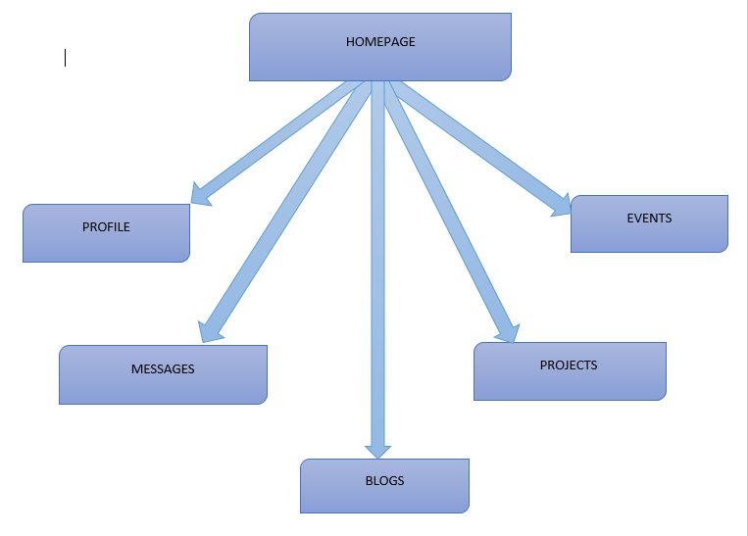
2.1 Design (flow of modules)
Fig 3.1 Timeline Chart

Slide 18
2.2 Modules
Module-1: Home Page
This will be the very first page after login.
User will be able to see blogs posted by others, notice on technical events, RSS news
feed which will be updated by latest news every time the pages refreshes.
Module-2: Profile Page
To create a profile user has to fill a form with various personal and educational details.
They also have to upload a picture of themselves.
After profile is created successfully the users post will be visible to others and can chat with each other.
User can any time update or edit their profile.
On my profile page information about their own post and profile picture will be displayed.
Module-3: Blogs /Discussions
Every blog posted will be stored in the database.
The comments/discussions on the blogs will also be stored.
Every user can see their own blogs in my profile tab.
And blogs by other users will be visible on the home page.

Slide 19
Module-4: Messages
Here the user will be able to chat with other users.
He will be able to search a user by their name and message them.
Every conversation will be stored in the database
Module-5: Projects
Once profile is created, they can upload their projects here.
Multiple files can be uploaded.
Files with .html, .py, .java, .c, etc can be uploaded.
These stored files can be accessed anytime.
Module-6: Events
Users can send notifications of events hosted by them to other users.
They must fill a form containing event details like Event description, start date, time.
Then these details will be send to other users as notifications.

Slide 20
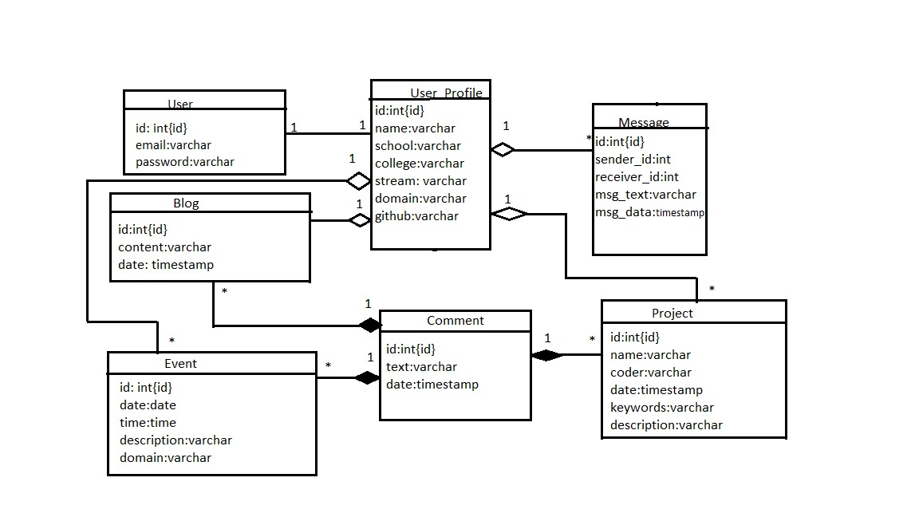
2.3 Class diagram
This diagram includes the class name, attributes, and operation in separate designated compartments.
Class diagram also defines the types of objects in the system and the different types of relationships that exist among them. It gives a high-level view of an application

Slide 21
3. Planning for
next semester

Slide 22
3.1 Planning
We are planning to design pages with HTML, CSS, and JavaScript technologies. Also adding backend features with help of PHP and will implement the database in the backend. To design user friendly web pages with connectivity between different modules and database. For database, we will be using MySQL. We will be creating a Landing page where our contact details and other information related to our website will be given. When the user registers or login they will land on Homepage. In the Homepage we will show RSS news feed, blogs related to technology. We will make a profile page where some personal and educational details will be asked from the user and a Profile will be created. Also we will be designing a chat box where every user can message every other user, discuss, share knowledge and clear their doubts about any topic of interest. We will create a page for blogs where users can read latest blogs related to technology and comment on the it.

Slide 23
Task name / Title | Planned start date | Planned end date | Duration(days)
Implementation Plan | 03-09-2020 | 31-03-2021 | 240
Topic selection | 03-09-2020 | 11-09-2020 | 8
Information gathering | 12-09-2020 | 20-09-2020 | 8
Topic approval | 21-09-2020 | 04-10-2020 | 13
Literature survey | 07-10-2020 | 25-10-2020 | 18
Requirement analysis | 05-11-2020 | 16-11-2020 | 11
System design | 02-12-2020 | 25-12-2020 | 23
Coding | 15-01-2021 | 05-02-2021 | 21
Testing | 08-02-2021 | 19-02-2021 | 11
Result and Analysis | 22-02-2021 | 05-03-2021 | 11
Deployment | 08-03-2021 | 19-03-2021 | 11
Final Report | 22-03-2021 | 31-03-2021 | 9
Fig 3.1 Timeline Chart

Slide 24
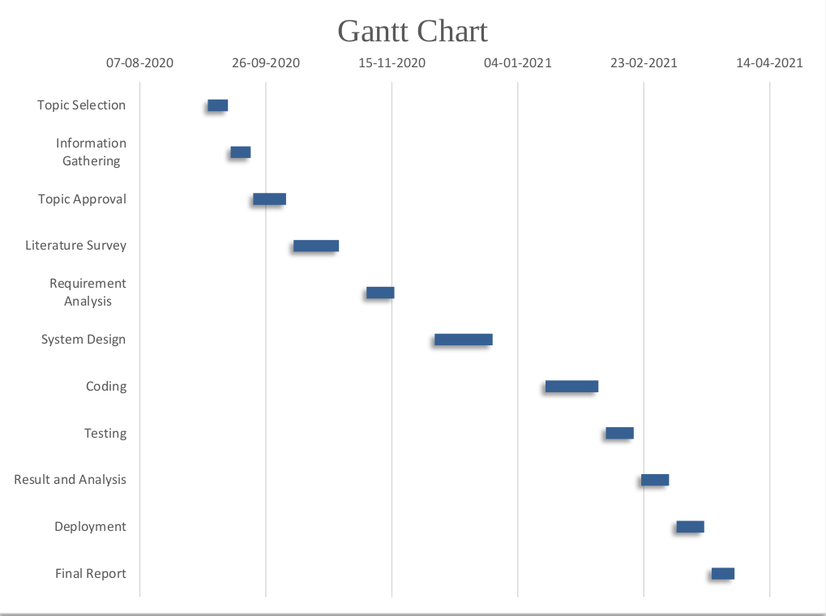
Fig 3.2 Gantt Chart

Slide 25
Conclusion
This platform will be primarily responsible for connecting like-minded students interested in technologies to come together discuss, share knowledge and socialize thereby truly making an international family of innovative students helping and building each other. With this platform students will be greatly benefitted throughout their project process, from selection of topics, group activities to final output. It will also be helpful for them to always stay updated with new innovations in industry and trends. It will help them to know about events of their choice and will be encouraged to attend and learn a new experience. It is going to be a great boon for students to get queries solved in short time and from users of different nations giving them the global exposure.

Slide 26
2.4 References
E-Books : [1] L.Welling and L. Thomson , Php and Mysql Web Development 5th Edition, AddisionWesley Professional , 2013 [2] B. Frain , Responsive Web Design with HTML5 and CSS: Develop future-proof responsive websites using the latest HTML5 and CSS techniques , 3rd Edition , Packt Publishing , 2020
Papers published in Conferences : [3] M. S. Chvanova , A. B. Kruyujova , I. P. Mitrofanova , A. E. Popovich and A. V. Samokhvalov , Development of Web-environment for Communication Between Mater’s Degree Students on Research and Innovation Issues , IEEE , 08 Nov 2018 , https://ieeexplore.ieee.org/document/8525006 [4] G. Singh and S. Sahu , Review on “Really Simple Syndication (RSS) Technology Tools” , IEEE , 14 Feb 2015 , https://ieeexplore.ieee.org/abstract/document/7078804 [5] N. Li and B. Zhang , The Design and Implementation of Responsive Web Page Based on HTML5 and CSS3 , IEEE , 02 Jan 2020 , https://ieeexplore.ieee.org/document/8945729 [6] A. Pinandito ,H. M. Az-zahra , L. Finani and A. V. Putri , Analysis of web content delivery effectiveness and efficiency in responsive web design using material design guidelines and User Centered Design , IEEE , 25 Nov 2017 , https://ieeexplore.ieee.org/document/8304178 [7] M. Bakaev and V. Khvorostov , Component-based Engineering of Web User Interface Designs for Evolutionary Optimization , IEEE , 29 Jun 2018 , Https://ieeexplore.ieee.org/document/8441135
Newsletter Article From Internet : [8] S.J.Cold , Using Really Simple Syndication (RSS) to enhance student research , ACM SIGITE Newsletter , Jan 2006 , https://doi.org/10.1145/1113378.1113379

Slide 27
Thank You

